Slide 1
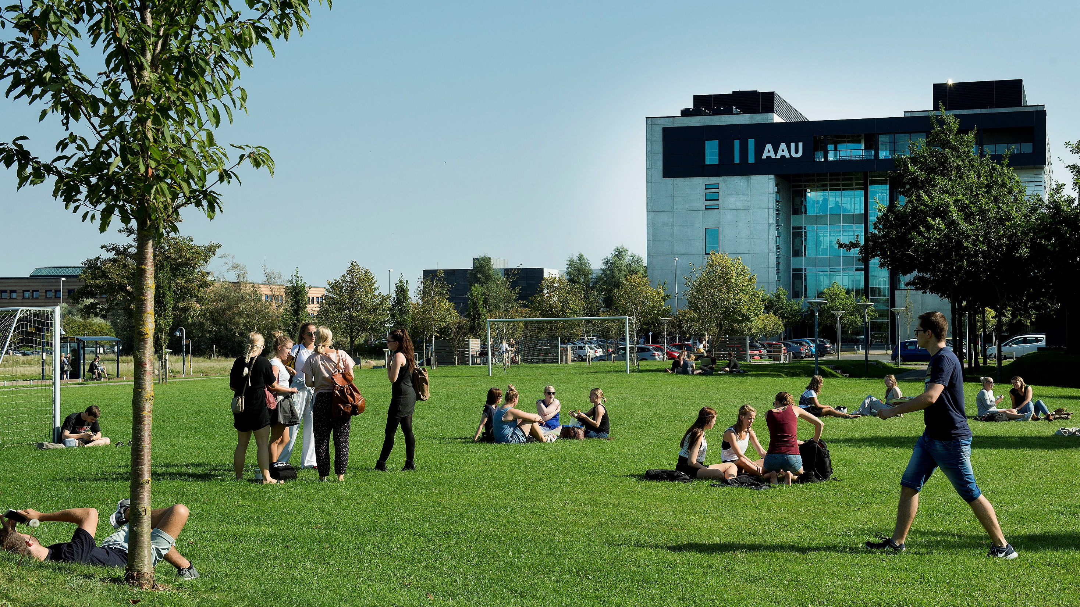

Slide 2
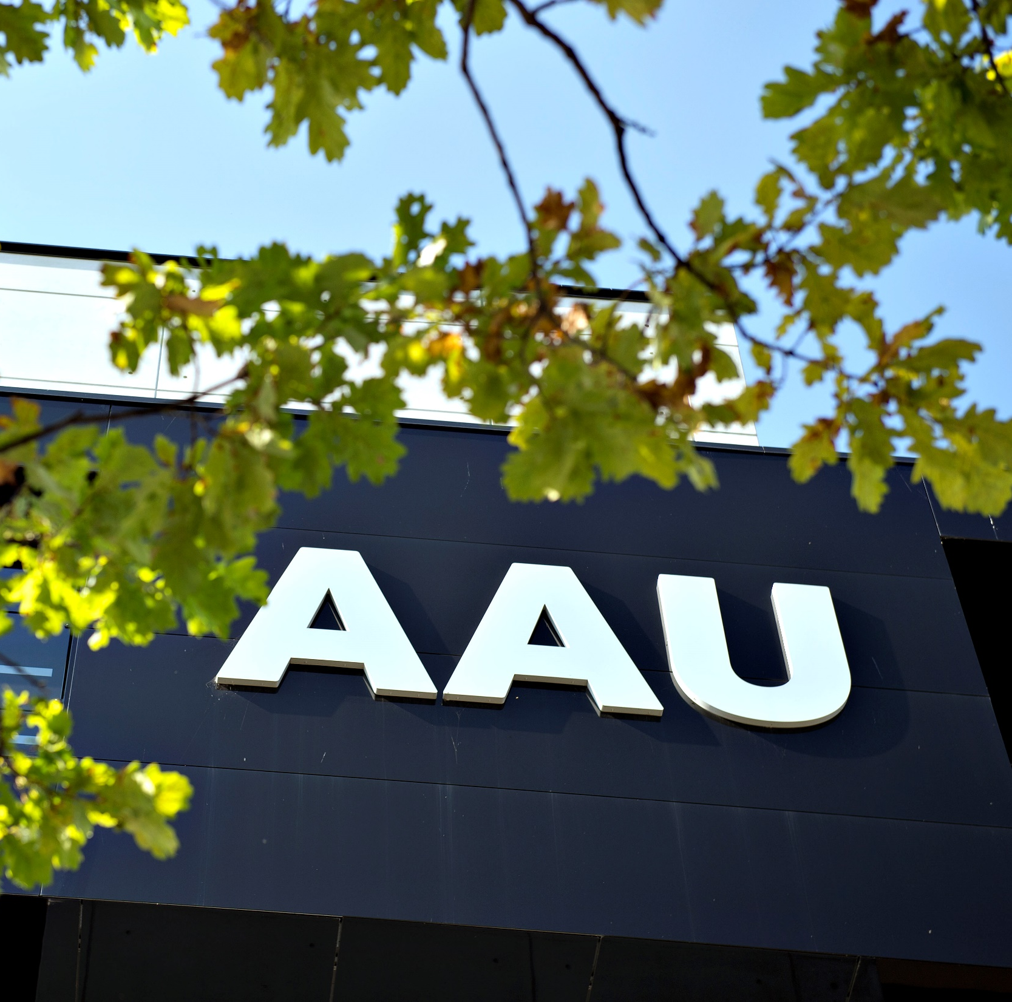
CONTENT
GENERAL GUIDELINES
STUDENTS
PBL
RESEARCH AND RANKING
BUSINESS COLLABORATION
STRATEGY 2016-21

Slide 3
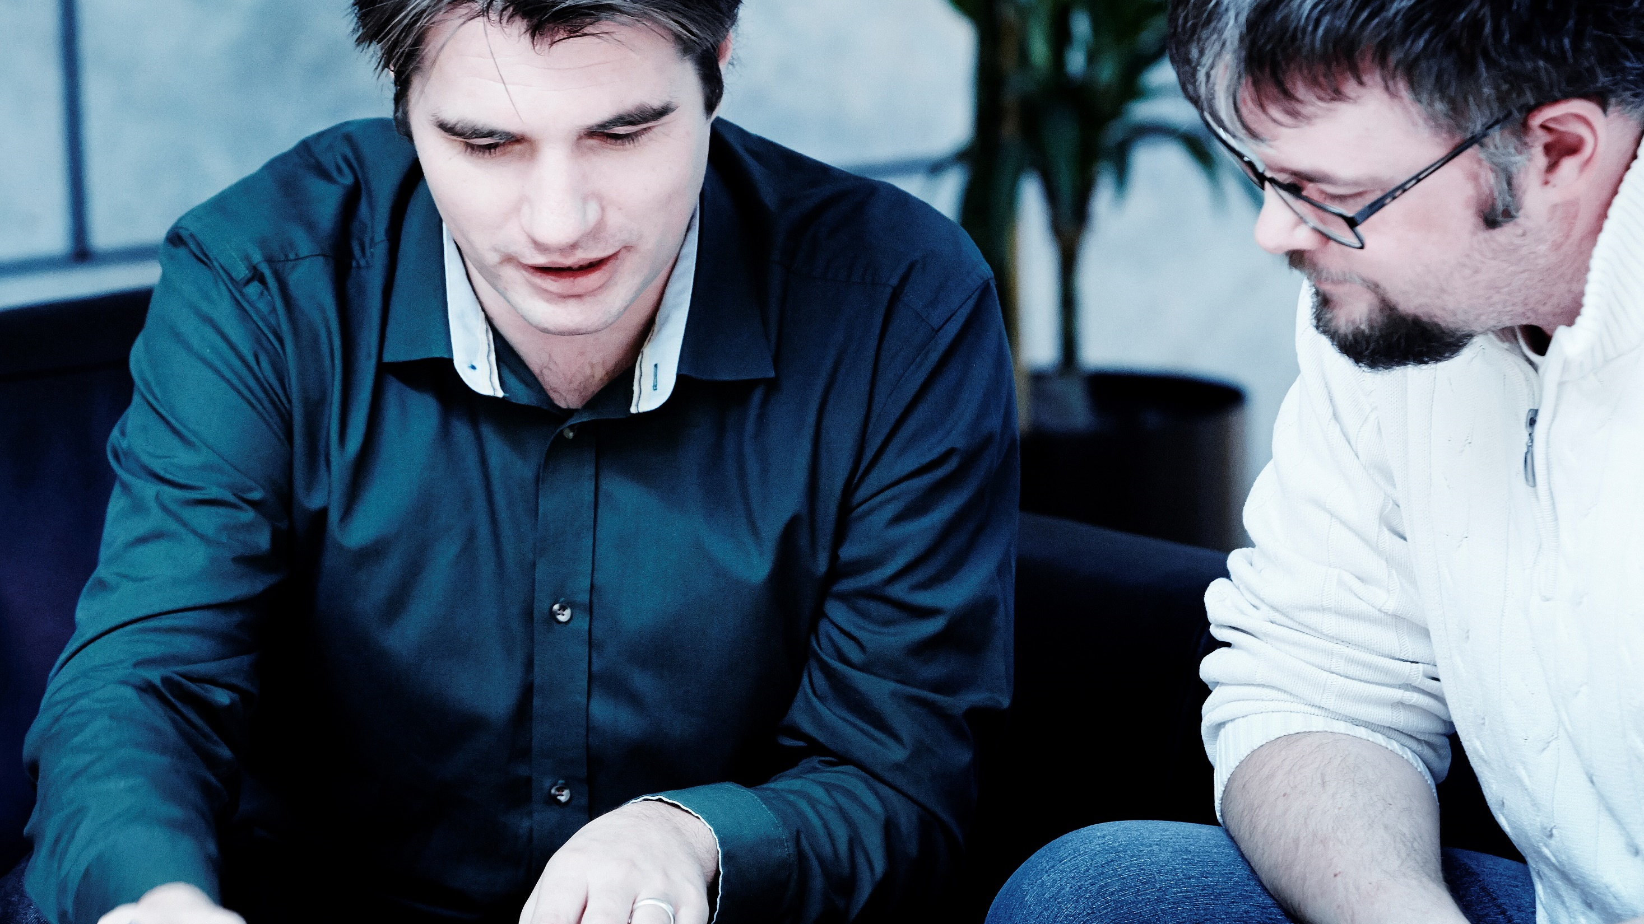
Introduction, change random picture

Slide 4
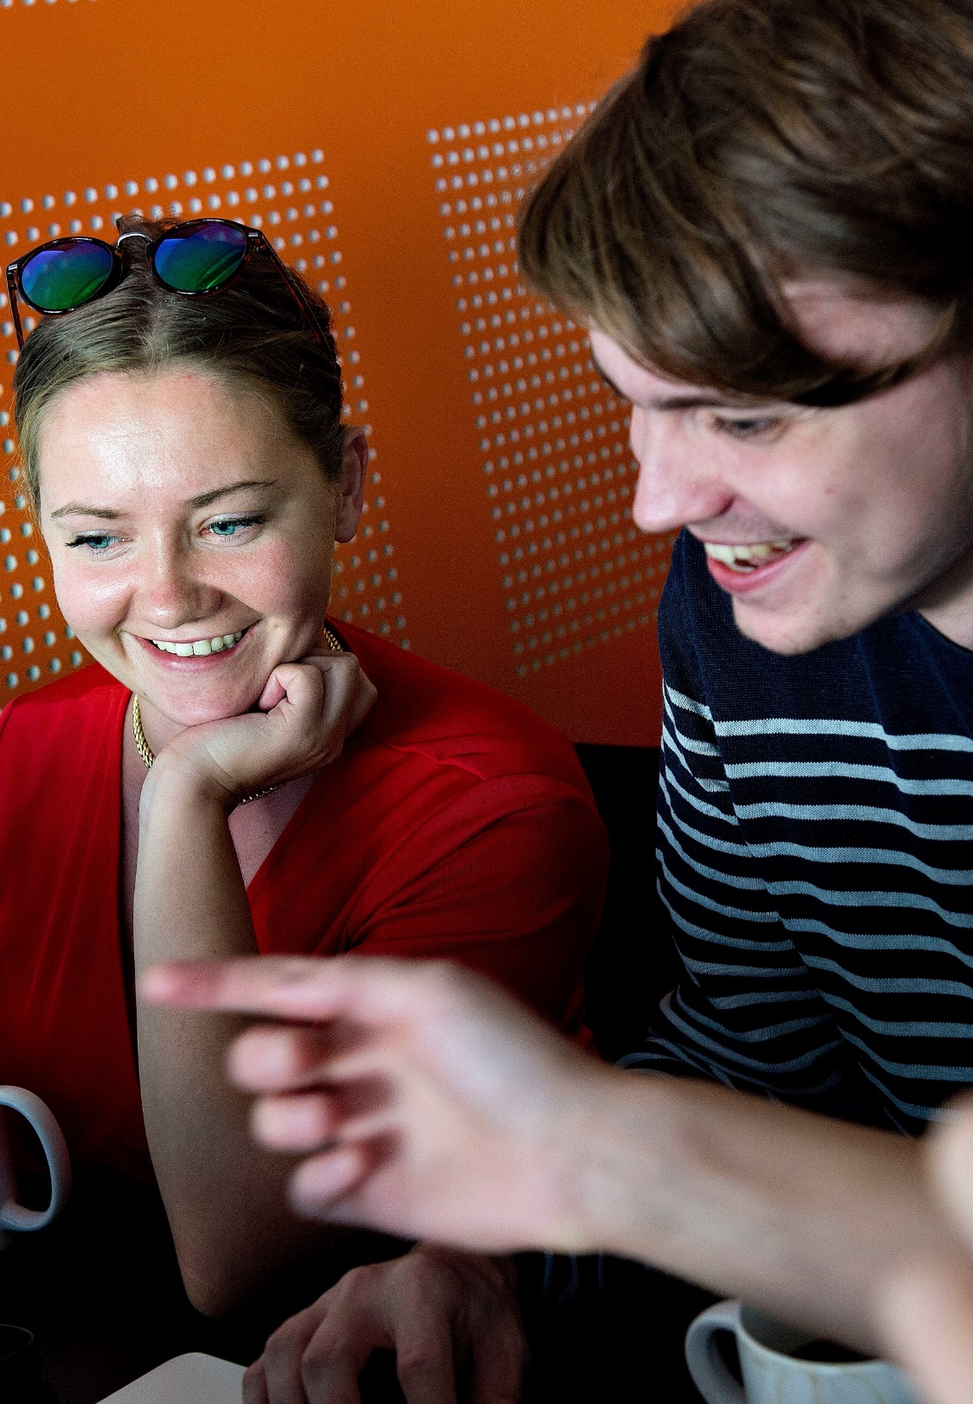
AAU – KNOWLEDGE FOR THE WORLD
All degree programmes and research activities at Aalborg University are problem and project-based and have an interdisciplinary focus.
Through strong interplay between staff and students and intense collaboration with public and private sectors, we offer degree programmes with a real-world approach and provide world-class research.
This results in new insights, new solutions to societal challenges and knowledge that changes the world.

Slide 5
AAU – KNOWLEDGE FOR THE WORLD
All degree programmes and research activities at Aalborg University are problem and project-based and have an interdisciplinary focus.
Through strong interplay between staff and students and intense collaboration with public and private sectors, we offer degree programmes with a real-world approach and provide world-class research.
This results in new insights, new solutions to societal challenges and knowledge that changes the world.

Slide 6
Time Management Table
Name | Time holding breath under water | Time without criticizing work | Time used for eating
Nicolai | 29:10 | 29:10 | 20:00
Thassilo | 10:02 | 10:02 | 20:00
Aitor | 00:17 | 00:17 | 20:00
Nicolas | 19:57 | 00:00 | ∞

Slide 7
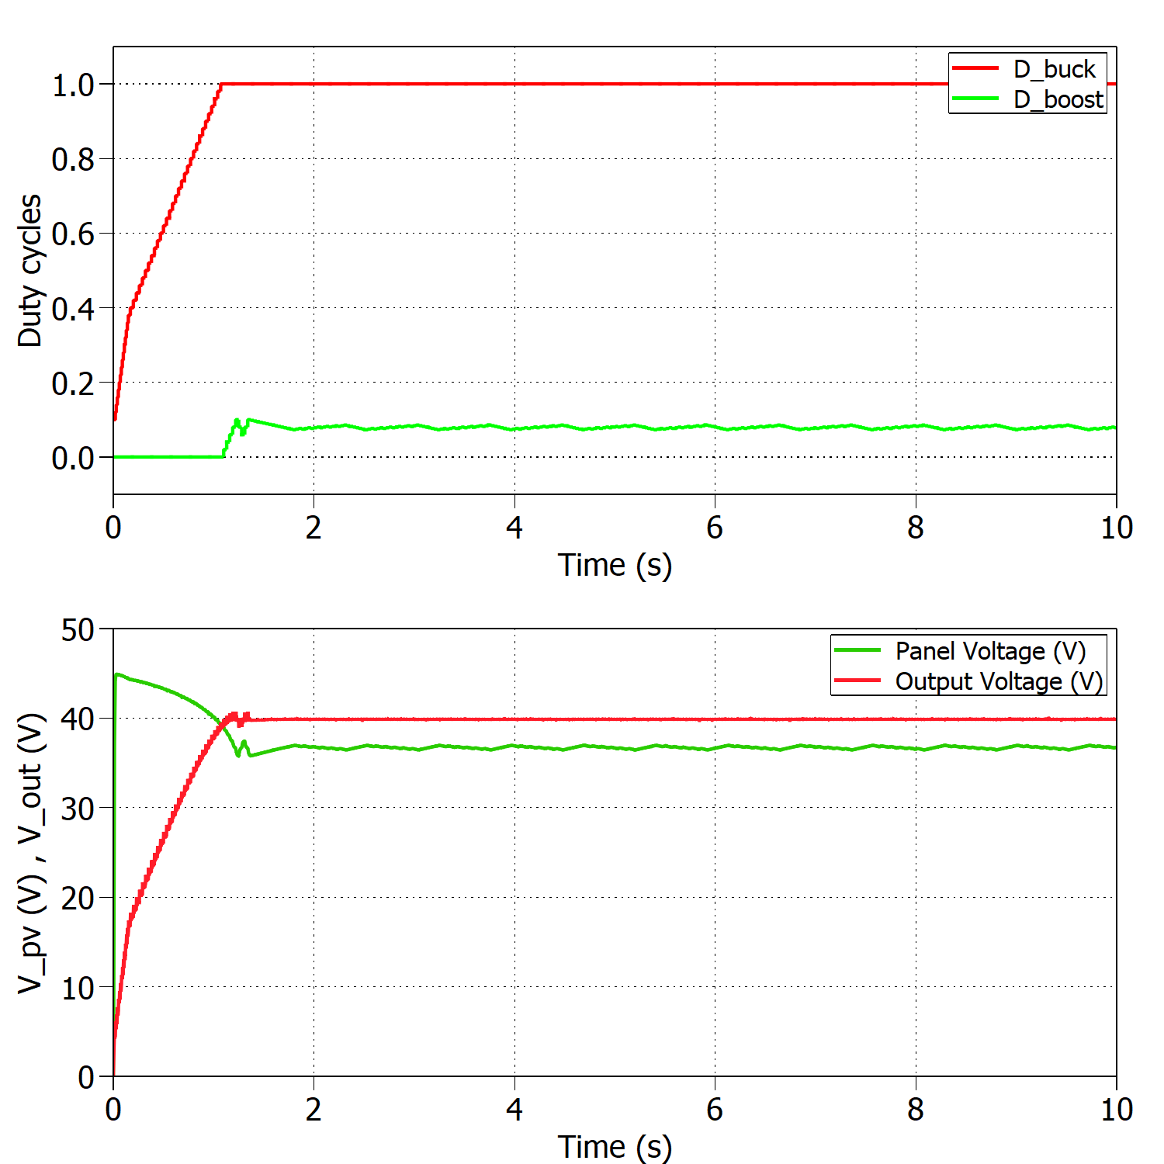
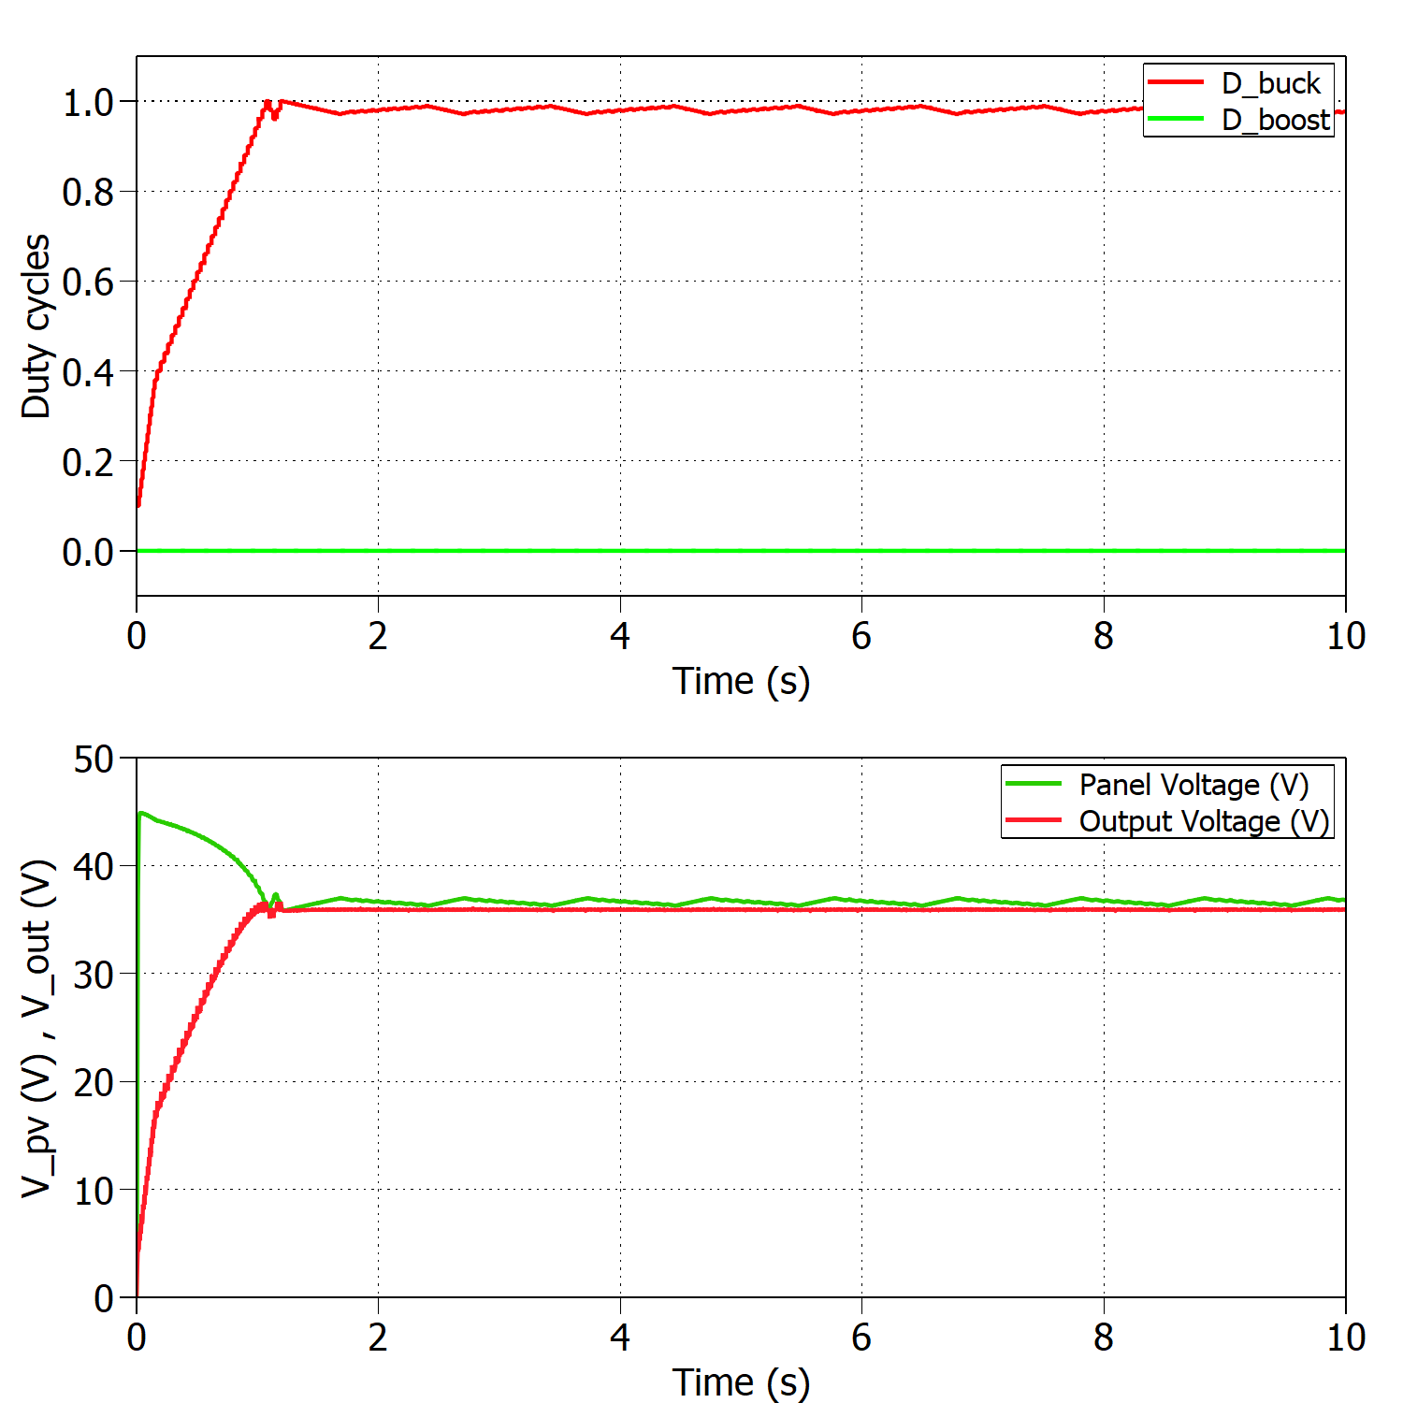
Time Management Table
Add a nice looking caption if you have multiple figures at one slide
And make sure that they are better aligned than this…

Slide 8
Converter design, change random picture

Slide 9
Converter design, change random picture

Slide 10
Converter design, change random picture

Slide 11
Converter design, change random picture

Slide 12
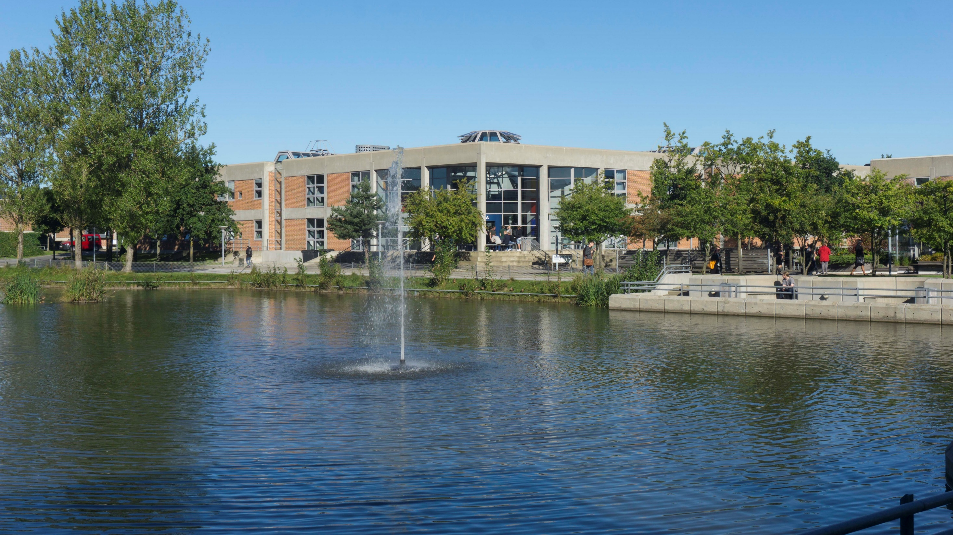
Thank you for your attention
Questions?

